Slide 1

Hosting a website for getting data ( S3 || API || Lambda(Python) || DynamoDB )

Slide 2




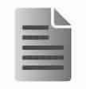
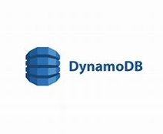
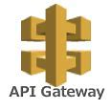

Architecture
Download
Public
Request
User/Client
Amazon S3
Resultant data
Get specific data
AWS Lambda
Response

Slide 3
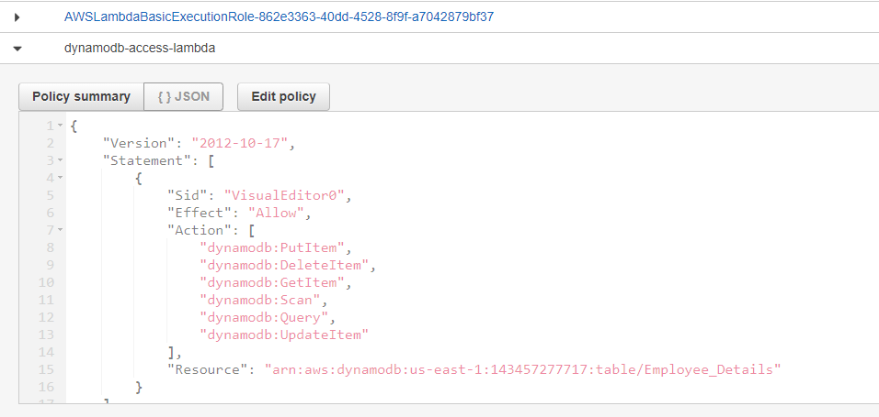
Step by Step process :
1. Create a dummy Lambda Function ## Function Name: host-web-for-get-data
2. Create an API gateway (REST API) --> Add Method (POST) --> Integrate the Lambda function --> Enable CORS --> stages < Note the URL for future use >
3. Create a dynamo database ## Table Name: Employee_Details < Copy the ARN for future use >
4. Attach an inline policy to the lambda function (host-web-for-get-data) IAM role --> dynamodb-access-lambda
< use the copied ARN > ​

Slide 4
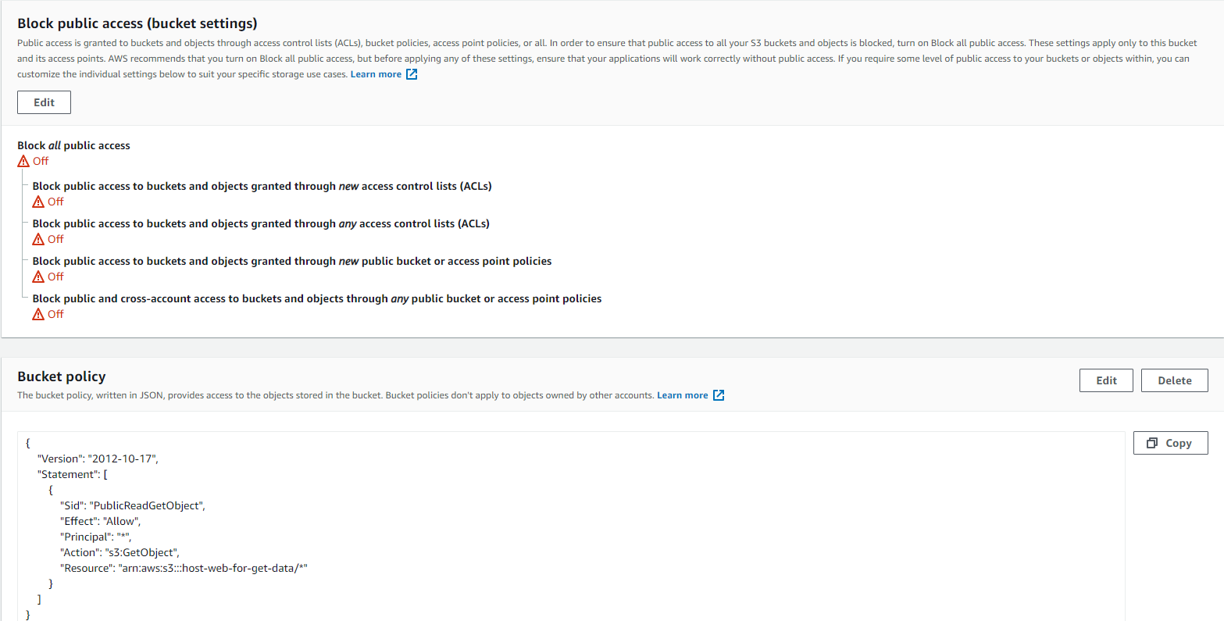
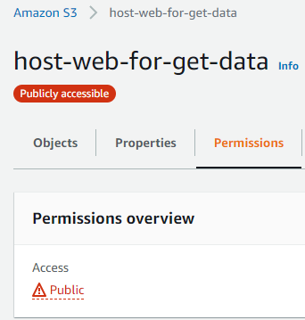
5. In S3, Create a bucket (Bucket Name: host-web-for-get-data) -- enable versioning
Allow Public access:
Uncheck the block public access
Add a bucket Policy
Now the bucket is Publicly accessible

Slide 5
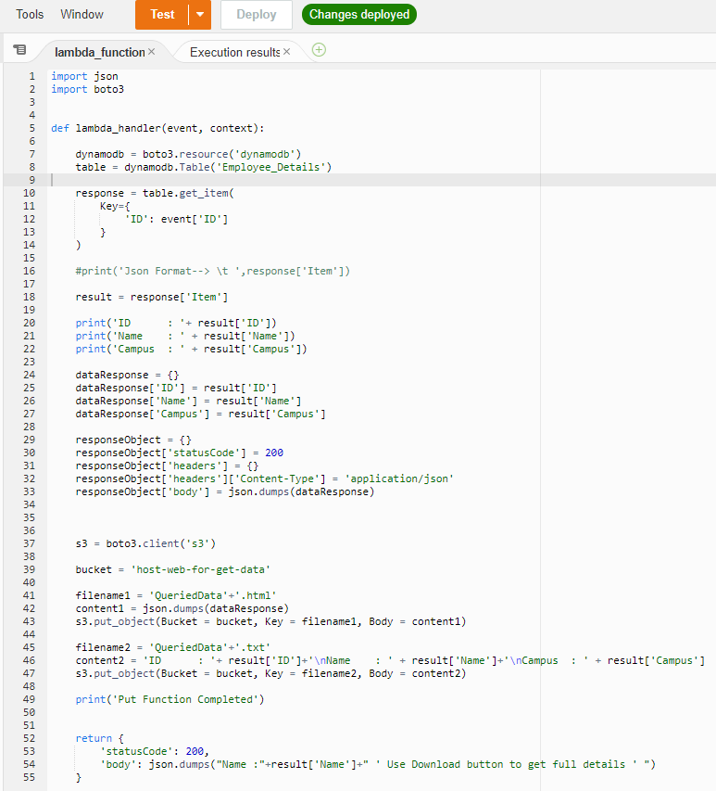
6. In lambda
(Function Name = Get-Data )
Code :
Get specific data From DynamoDB based on ID
Store resultant data in S3 (.txt & .html file)
Get Specific data based on ID
Store the result file in to S3
Response message

Slide 6
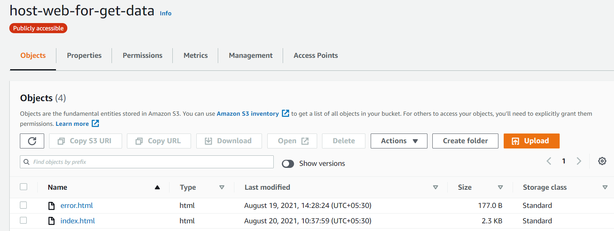
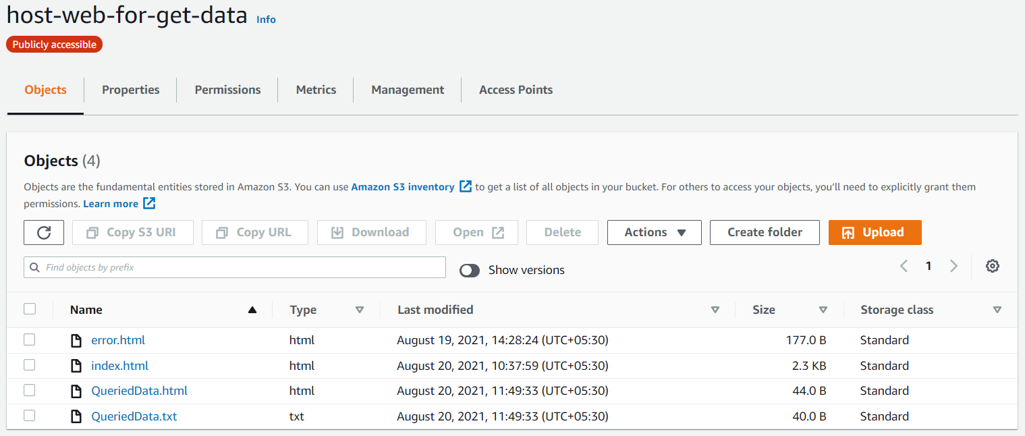
Before Lambda works
7. Create and upload index.html & error.html files
Enable static website hosting ( Note the URL for client access)
After Lambda Tested Successfully, It created two files that holds the result data.
After Lambda works

Slide 7
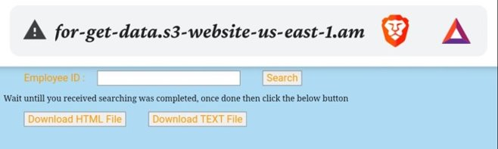
Index Page
Use Employee ID : 1 or 2
Click Search button

Slide 8
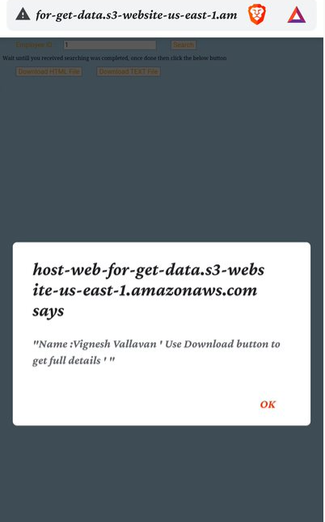
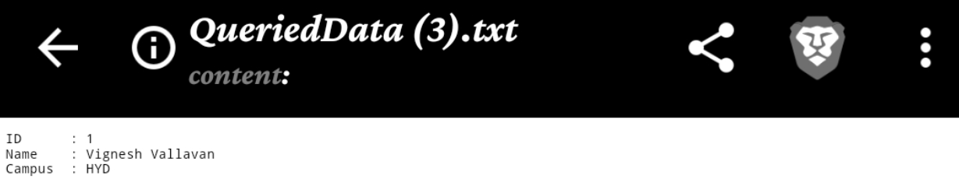
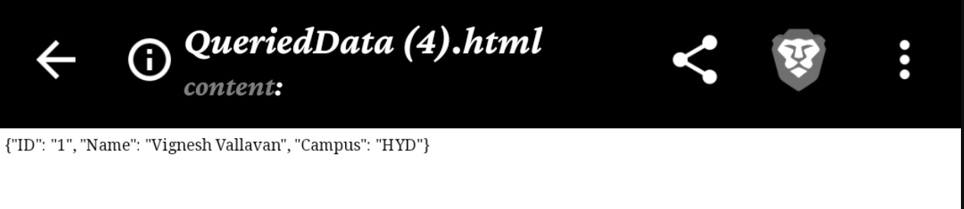
Employee ID : 1
Downloaded File

Slide 9
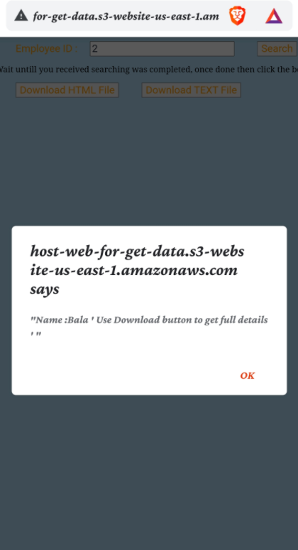
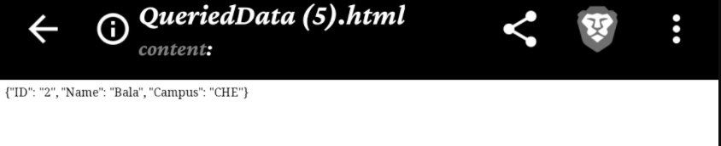
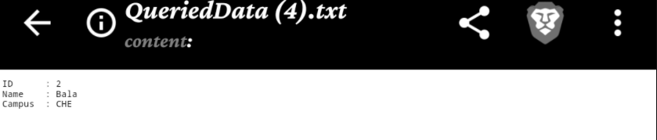
Employee ID : 2
Downloaded File

